Slide 1

ONLINE BOOK STORE
2200090054-Ch.venkat syam kumar
2200090045-K.chaithanya

Slide 2
ADVANTAGES ONLINE BOOK STORE
If you compare buying books from a conventional store and online bookstore, when you enter a store, you have to settle at the price which the vendor has placed on a particular book but with an online store, you have the privilege to compare the price from different stores.

Slide 3
DISADVANTAGES ONLINE BOOK STORE
Technological Limitations. Online reading is highly dependent on technology. ...
Health Implications. Digital devices such as smartphones, laptops, tablets, etc., emit harmful blue light from their screens. ...
Highly Addictive. ...
Misinformation. ...
Minimum Contentment.

Slide 4
FUNCTION OF THE ONLINE BOOK STORTE
An online book store is a web application that allows customers to buy books online. Customers can search for a book by title or author using a web browser, add it to their shopping cart, and then purchase it using a debit or credit card transaction.

Slide 5
OBJECTIVE OF THE ONILINE BOOK STORE
“Usually in textbooks, objectives are not just used to plan the text, but they are made explicit [to readers]. Objectives can be written out at the start of chapters and/or sections or inserted where appropriate.” Learning objectives for your textbook can be written using Bloom's Taxonomy of Educational Objectives.

Slide 6
MODULES OF THE ONLINE BOOK STORE
The goal of this project is to create a website that serves as a central book store. This website was built with php on the front end and SQL on the back end. Various book-related details are stored in the SQL database. A user visiting the website will find a wide selection of books organized by category.

Slide 7
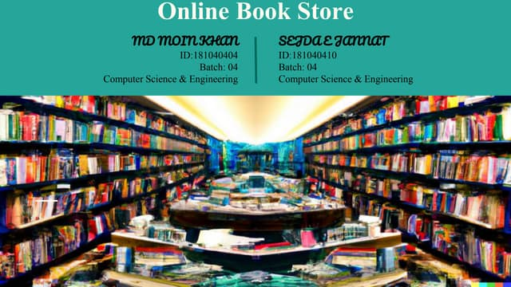

Slide 8
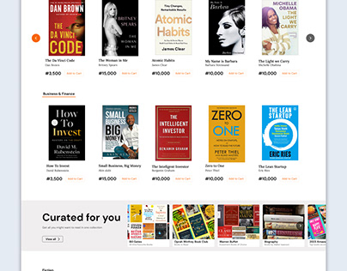

Slide 9


Slide 10
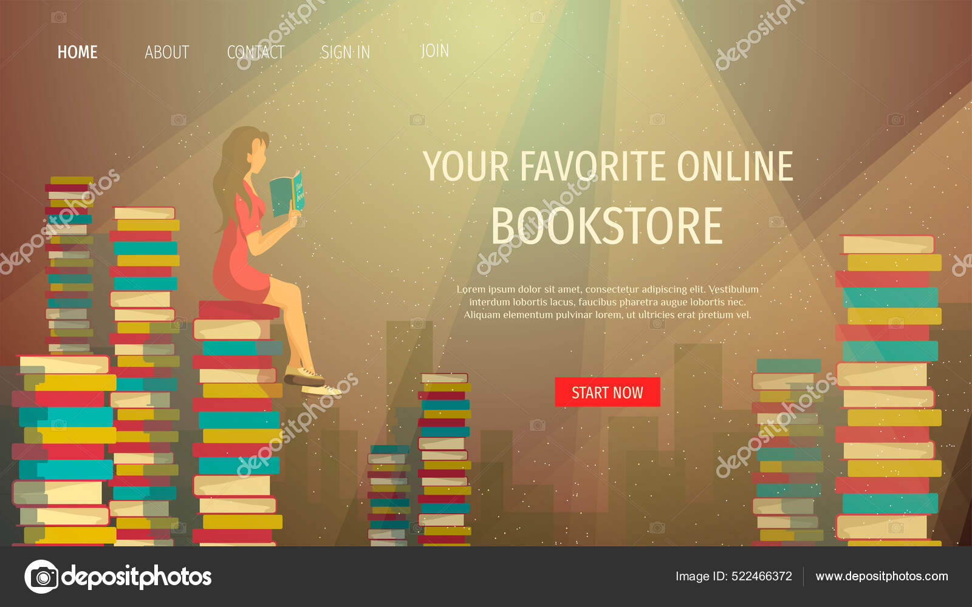

Slide 11


Slide 12


